Slide 1
Extinction

Slide 2
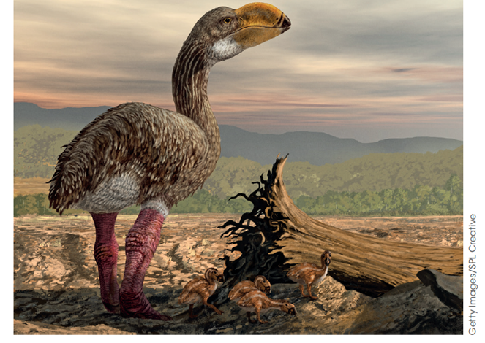
Extinction
Refers to the death of an entire species. No individuals are left alive.
Extinction occurs quite rarely but there have been periods when the rate of extinction has been quite high. These are mass extinctions.
Most species that have ever lived are now extinct.
The extinction of one group has allowed another to undergo extensive radiation into free niches. Eg Extinction of the dinosaurs gave rise to the adaptive radiation of mammals.

Slide 3
Background Extinction Rate
Extinctions are a normal part of evolution.
The background extinction rate is a measure of how often extinctions naturally occur.
The causes of extinction vary.
Studies of the fossil record show that each taxonomic group has species with a characteristic “duration of existence” before becoming extinct.
This provides the average background extinction rate for the taxonomic group.

Slide 4
Background Extinction Rate
Taxonomic Group | Species duration (millions of years)
Mosses and liverworts | 20+
Higher plants | 8-20+
Bivalves | 11-14
Snails | 10-13
Ammonites | 1-15
Trilobites | 1+
Beetles | 2+
Freshwater fishes | 3
Snakes | 2+
Mammals | 1-2+

Slide 5
Mass Extinctions
Superimposed on the average background extinction, there are five mass extinctions events in the Earth’s history.
A mass extinction is an abrupt increase in extinction rates affecting huge numbers of species at the same time.
      Dinosaurs became extinct during the Cretaceous extinction 65 mya.

Slide 6
5 mass extinctions
There have been 5 mass extinctions documented in the fossil record within the last 500 million years (there have been many before that too)
    444 mya End of Ordovician period 86% of species lost
    375 mya, Late Devonian 75% of species lost
    250 mya End of the Permian Period 96% of species lost
    200 mya End of the Triassic period 80% of species lost
    65 mya end of the Cretaceous period 76% of species lost (mass extinction of dinosaurs)

Slide 7
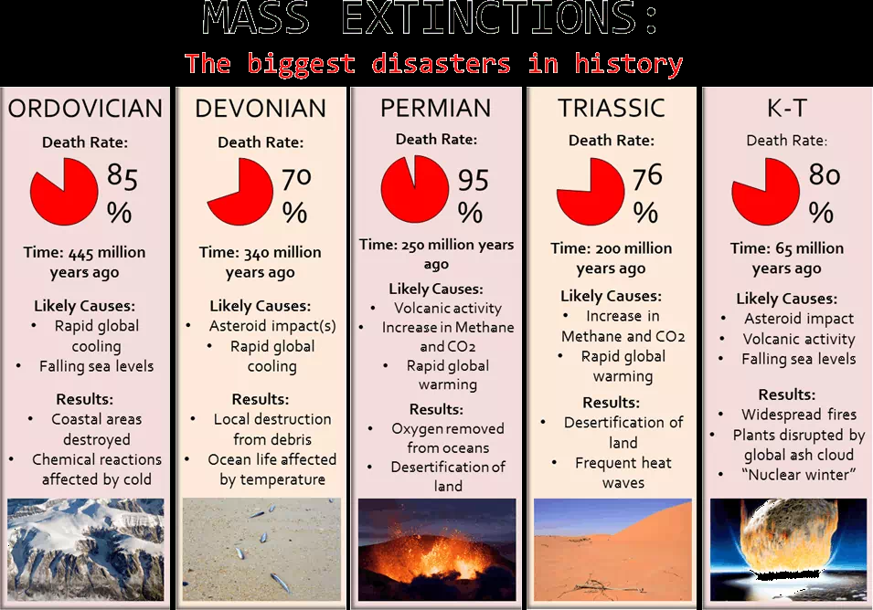
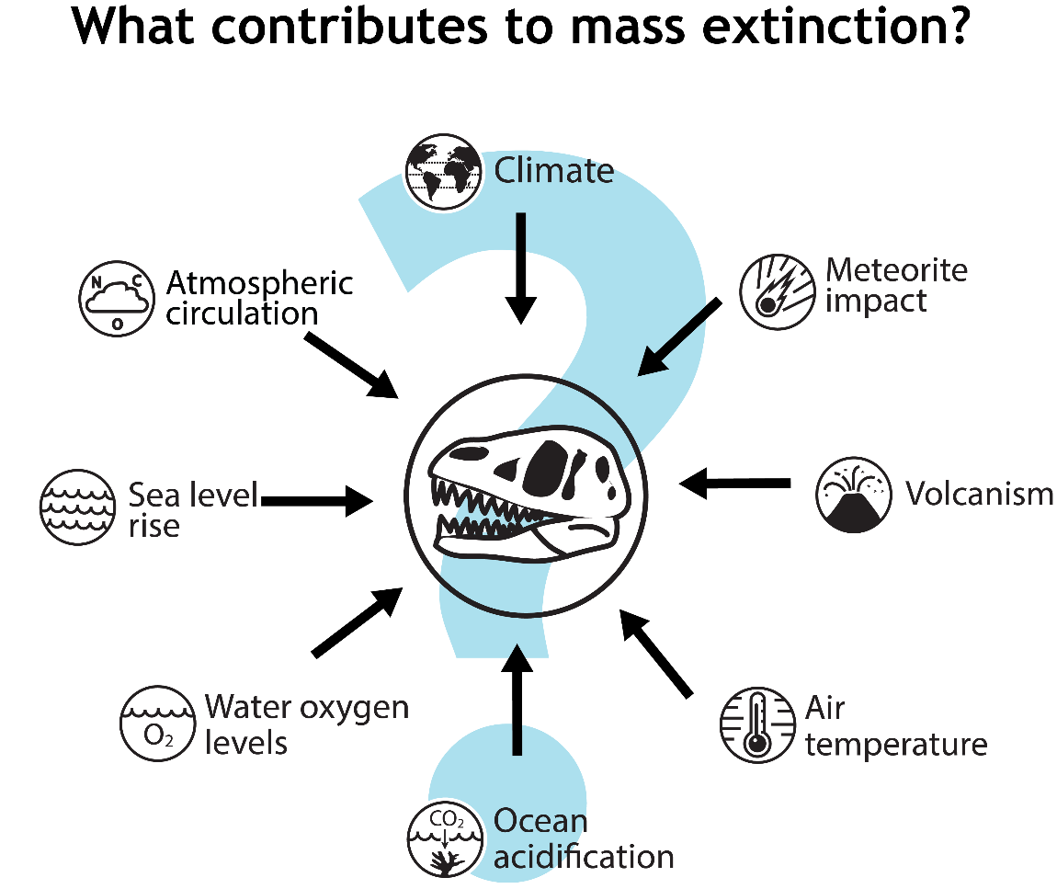

Slide 8
Causes of Mass Extinction
Catastrophic events:
  Changes in climate due to continental drift
  Sea level changes caused by successive ice ages and interglacial periods.
  Dust from volcanic activity, causing a cooling of the planet.
  Asteroid/comet impact causing dust cloud and cooling effect.

Slide 9
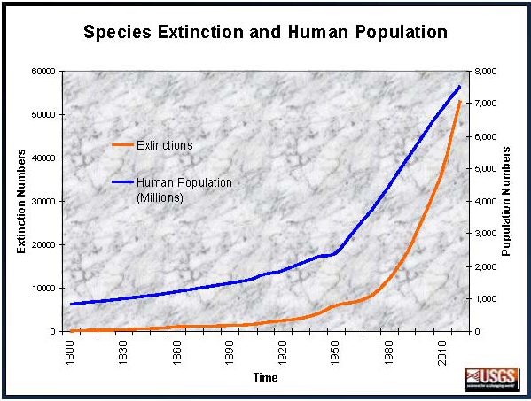
The Sixth Extinction (Holocene extinction)
This current extinction is characterised by the presence and wide-reaching activities of humans.
Started approx. 50 000 yrs ago when humans first spread out of Africa across Asia, Europe & Australia & continues today
Agricultural practices, environmental destruction, climate change
It includes the Holocene extinction of the mega fauna and is ongoing.
The observed rate is more than twice expected by the normal background extinction rate.

Slide 10
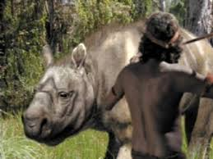
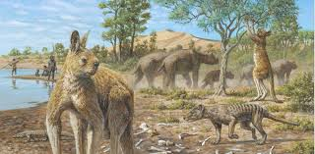
Mega fauna

Slide 11
Watch
https://www.youtube.com/watch?v=eA151sBcCag
https://www.youtube.com/watch?v=z9gHuAwxwAs&list=PLsMs3sjjy-pCcR8l3ohnIUhIiCwEjQB6K&index=39&t=0s

Slide 12
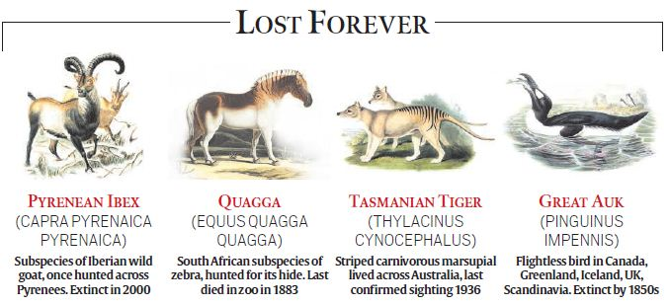

Slide 13
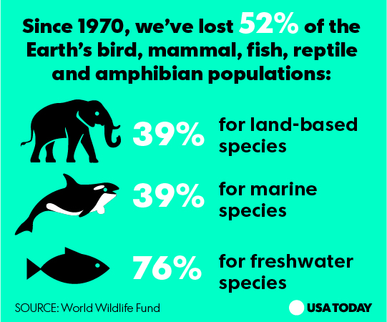

Slide 14
Extinction of species
Australian bushfires and species extinction
More than 1 billion animals were killed in the 2019/2020 Australian bushfire season. Endangered species, including the long-footed potoroo, Kangaroo
Island’s glossy black-cockatoo and Batemans Bay’s spring midge orchid were pushed towards extinction.
The devastating wildfires undid decades of careful conservation work on Kangaroo Island and have threatened to wipe out some of the island’s unique fauna altogether.
Getty Images/Lisa Maree Williams

Slide 15
The Sixth Extinction
Causes
  Human population growth
  Industrialization
  Rainforest and wetland destruction
  Climate change
  Overharvesting of natural resources
  Pollution and waste.

Slide 16
The Sixth Extinction – Preventing extinction
Conservation is aimed at slowing or managing this extinction process by maintaing genetic diversity
Having a larger gene pool means having more alleles to draw upon to face the pressures of natural selection.
When making conservation plans to maintain viable gene pools it is important to consider biogeography, reproductive behaviour & population dynamics
By considering each of these three areas enables conditions to be created which may ensure conservation plan effectively maintain viable gene pools

Slide 17
Importance of Genetic Diversity
During large scale extinction not all species are lost
Large populations are more resilient than smaller populations
Larger populations can have a more diverse gene pool
  A greater reserve of different alleles
Loss of genetic diversity through the random loss of genetic variation due to extinction is genetic drift
Small populations have a high level of inbreeding as only have a few individuals that can reproduce
Inbreeding results in a loss of genes/alleles & the gene pool would come to reflect only the genetics of a few individuals

Slide 18
Extinction of species
Preventing extinction by preserving genetic diversity
Populations with reduced diversity face increased risk of extinction, so conservation projects usually focus on maintaining genetic diversity.
Rapid extinction events can lead to greater loss of large organisms than of small ones. A large distribution area is generally a big advantage, because it may allow some pockets of habitat to survive.
Large population size can also be some protection, because the population is likely to have a more diverse gene pool and thus a greater variety of alleles and phenotype options as the pressures from natural selection change.
Biology WA Units 3 & 4
Set 9.8 pg.317 Q 1-4

Slide 19
Strategies to preserve genetic diversity
Some strategies to preserve genetic diversity include:
Captive breeding programs
Seed banks
For these strategies to be successful need to consider:
  Reproductive behaviour
  population size of breeding individuals (prevent inbreeding) – Population Dynamics
  genetics of individuals (DNA profiling/DNA Sequencing to determine if related)
  Biogeography

Slide 20
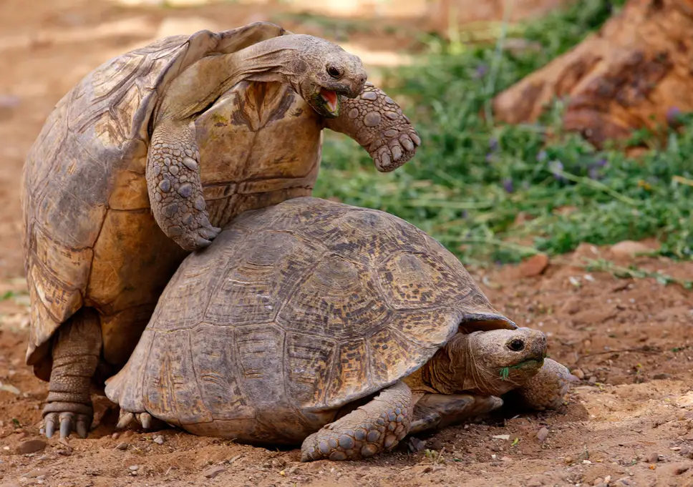
Reproductive behaviour
  When designing a captive breeding program it is very important to consider an animals reproductive behaviour including:
  when an organism reproduces in order to ensure survival of its offspring
  What the organisms needs are in order to feed & protect its young
  Requirements of nests
  How long it nurtures its young
  The extent of parental care provided
The genetics of the organisms need to be determined through DNA profiling involved will also need to be considered to reduce inbreeding

Slide 21
biogeography
Study of the distribution of organisms & ecosystems across the world through geological time
Having an understanding of an organism’s geographic distribution enables an understanding of its tolerance to biotic factors in the area
  For example: food it requires, ability to survive predation, competition
Also enables an understanding of its tolerance of abiotic factors present in its environment
  For example: effect of temperature changes, pH changes and other climatic factors can be better understood
  This helps to answer the question about whether the Nature Reserve, Conservation Area, National Park is large enough & has suitable conditions within it to maintain viable populations of the species

Slide 22
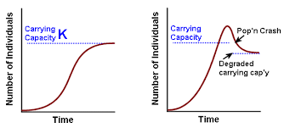
Population Dynamics
Conserving the population in situ understanding the natural population dynamics of the species is important because:
  Knowledge of the birth & death rates enable estimates of the population’s expected growth rate
  Measures may be necessary to increase the birth rate & decrease the death rate of the population if it is to grow

Slide 23
Conservation Strategies
Genetic
  Seed banks – preserve rare/threatened plant species
  Captive breeding programs –prevent extinction, reintroduce species into the wild
Environmental
  Revegetation
  Control introduced species
Management
National Parks & State reserves - Conservation reserves protect endangered species from human influence and predation.
It is difficult to know how large reserves need to be to be effective.
Does there need to be a single large or several small (SLOSS) reserves?
  Restricted commercial & recreational access
  Education
  Go through the following three slides & add the benefits of environmental & management strategies

Slide 24
Video Link
Https://www.youtube.com/watch?v=z9gHuAwxwAs
Biozone Act 246

Slide 25
Genetic strategies to maintain genetic diversity
Example | Benefits
Captive breeding programs (zoos, wildlife parks) | Increase the population numbers and reintroduce into the wild. Prevents extinction.
Seed banks (Botanical Gardens, Millennium Seed Project) | Preserve rare or threatened plant species. Grow plants to rehabilitate areas.
DNA profiling | Provide a data base to identify individuals taken from the wild. Used in breeding programs to increase biodiversity.
Genetic research programs | Development of new strains such as drought resistance. Genetically modified plants to help survive in a changing environment.

Slide 26
Environmental Strategies
Example | Benefit
Reduce introduced species
Use of biological controls
Remove weed species
Implement reafforestation
Wildlife corridors | can link otherwise isolated conservation areas and allow animals to move to new areas when resources become scarce.

Slide 27
Management Strategies
Example | Benefit
Conserve large areas of diverse natural ecosystems Reserves and Parks (Terrestrial and Marine)
Reduce human consumption Bag Limits/Catch size/Hunting Seasons
Community education programs
Restricted Commercial and Recreational access
Surveys of natural ecosystems
Encourage recycling
Provide bush corridors that link natural ecosystems

